Slide 1

INFO-6001
Information Security
LAB ASSIGNMENT 8
Backdoors, Trojan & ADS
SUBMISSION TEMPLATE

Slide 2
INFO6001 Lab Assignment 8 A & B
Gihan Shamike Liyanage
1142109
23W - 04/06/2023

Slide 3
PLEASE include in screen capture / snips:
* VMware tabs showing course ID and OS
* Work, names & paths from lab steps prior to capture:
e.g. Log in as student1, go to xyzfolder try to open abcfile, then 7. capture error message to slides submission
Remember to use firstname, lastname, as it appears in FOL and yourfolname as it appears in your log-in or FOL email (FOLID).
The mfilebinder directory should already be in the Win7 Hacker image in the Security folder. If needed, the archive has been renamed Innocent_Files.rar and included below and under Content / Exercises to avoid triggering any Anti-virus response that FOL or your Host may have to the tools actual name.

Slide 4
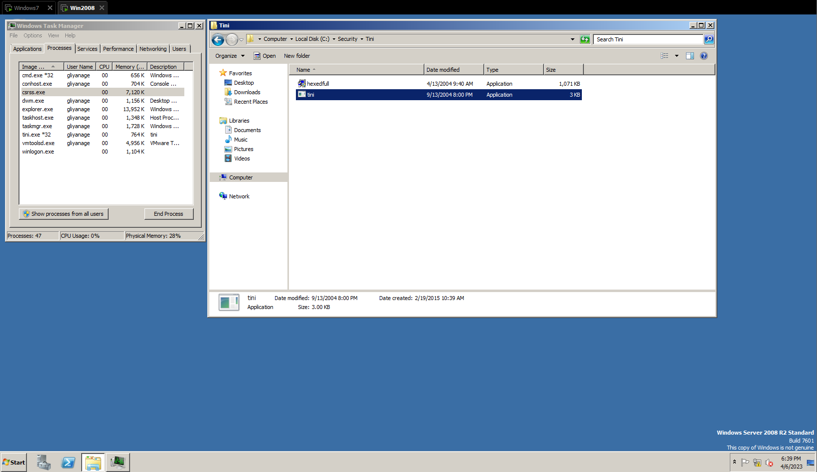
Slide #1 – TaskManager Processes

Slide 5
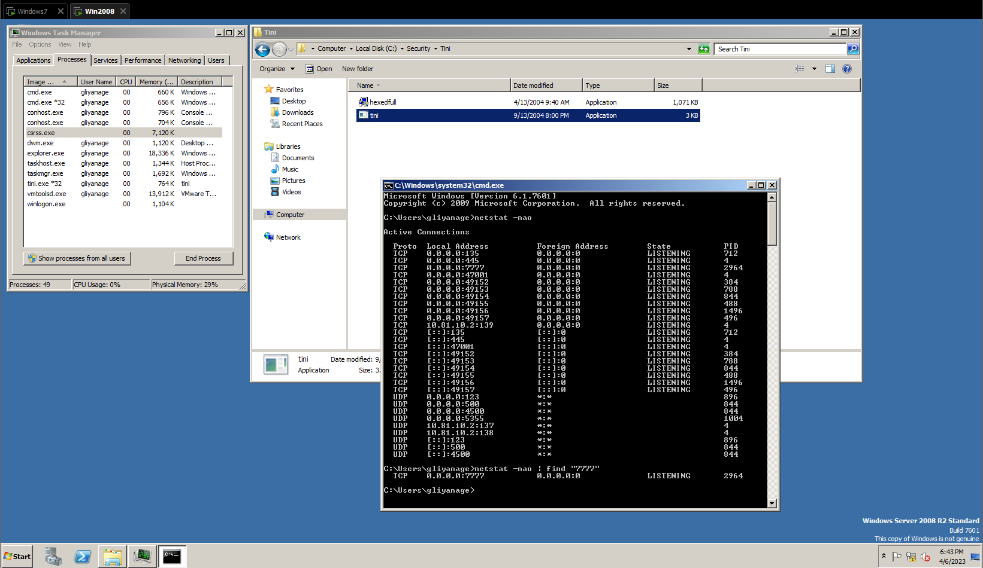
Slide #2 Netstat

Slide 6
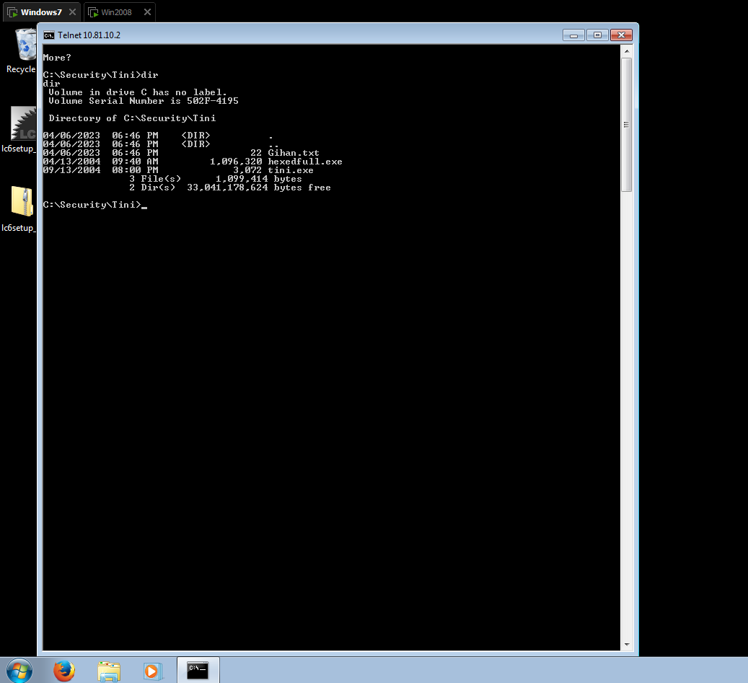
Slide #3 Security\tini> dir

Slide 7
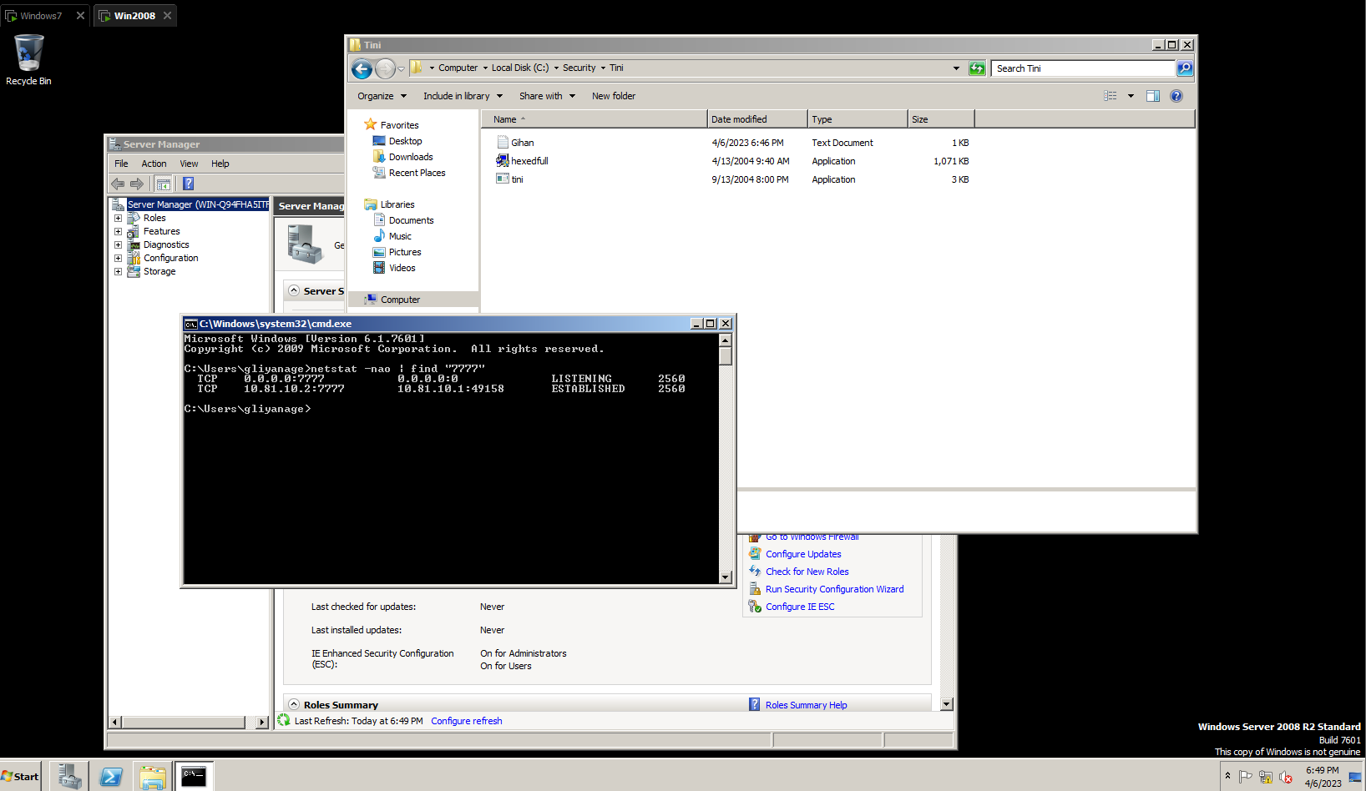
Slide #4 Netstat with connection

Slide 8
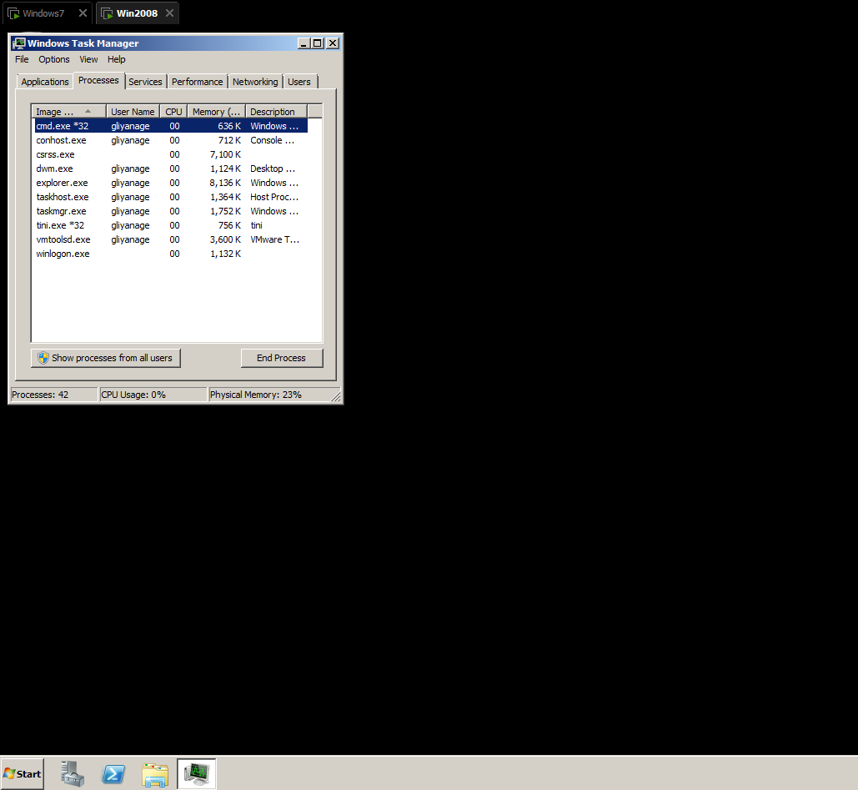
Slide #5 TaskManager – Tini owner

Slide 9
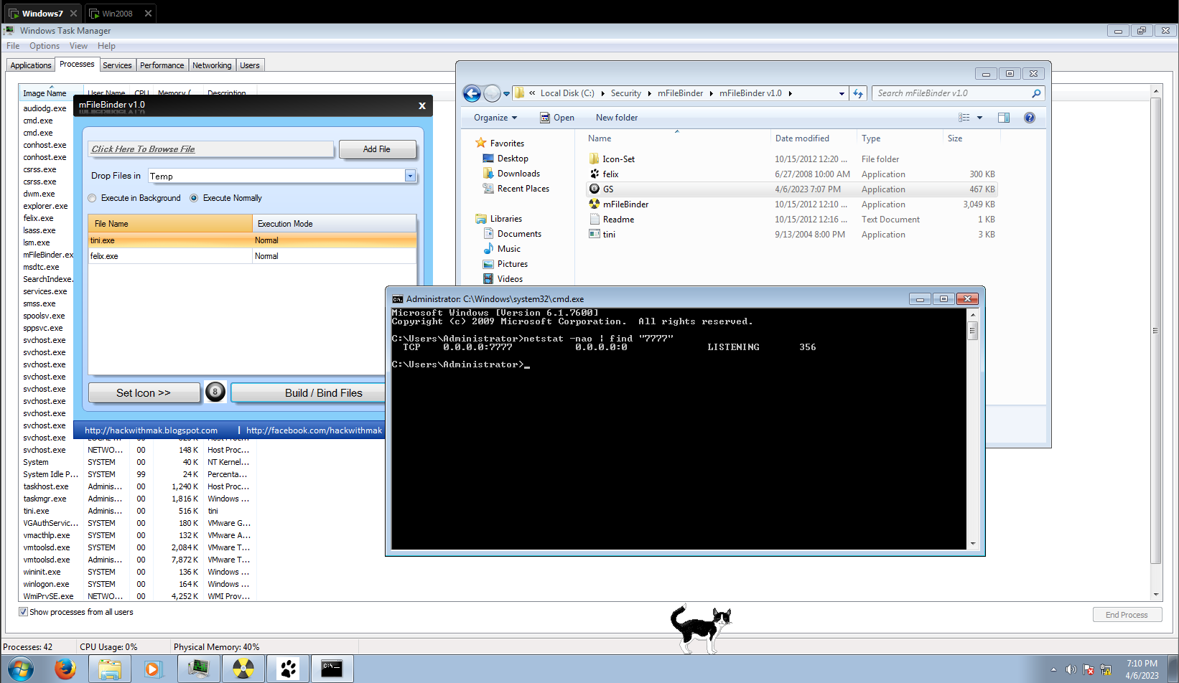
Slide #6 Netstat & Felix

Slide 10
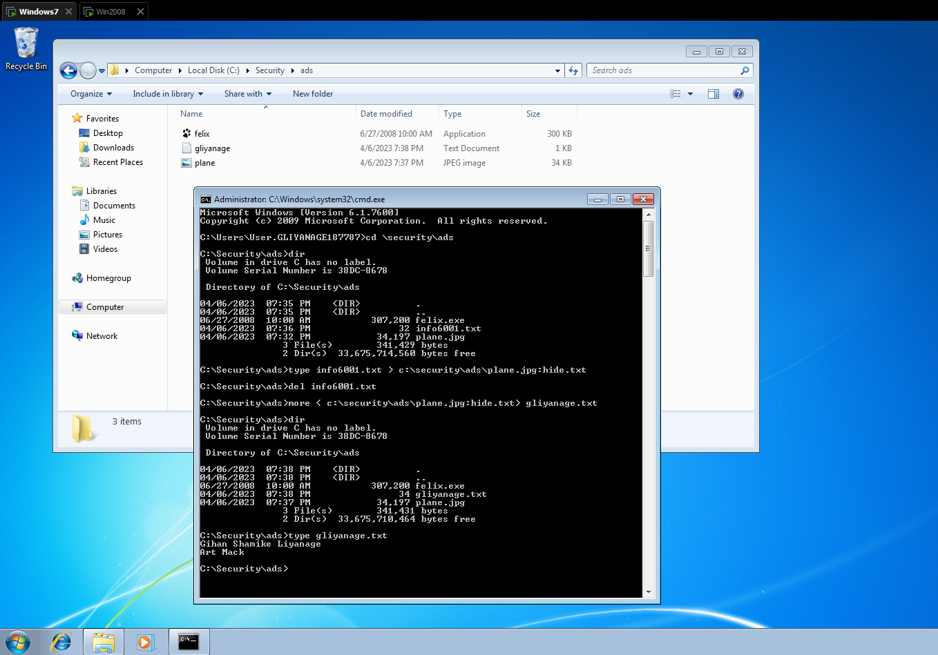
Slide #1 dir & type commands

Slide 11
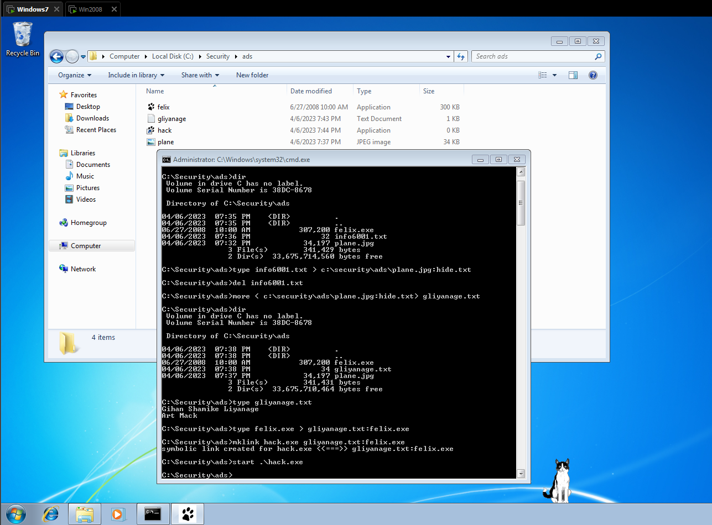
Slide #2 CMD Prompt & Felix

Slide 12
Did felix run? No
Do you see the cat on the desktop? No

Slide 13
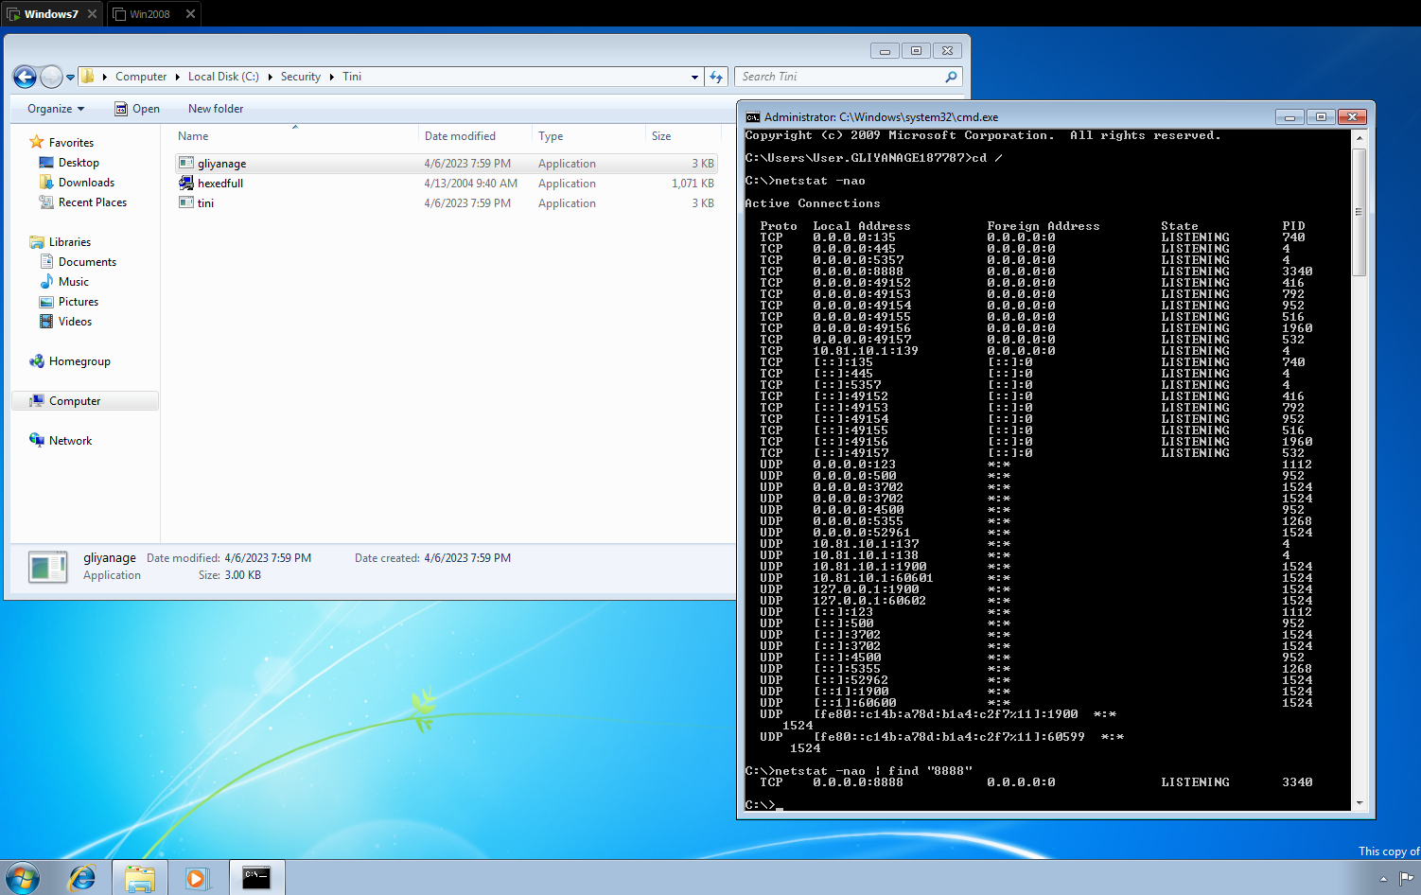
Slide #3 Netstat

